Slide 1
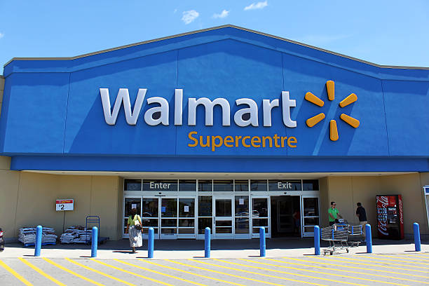
Walmart Sales Analysis
SQL Project

Slide 2
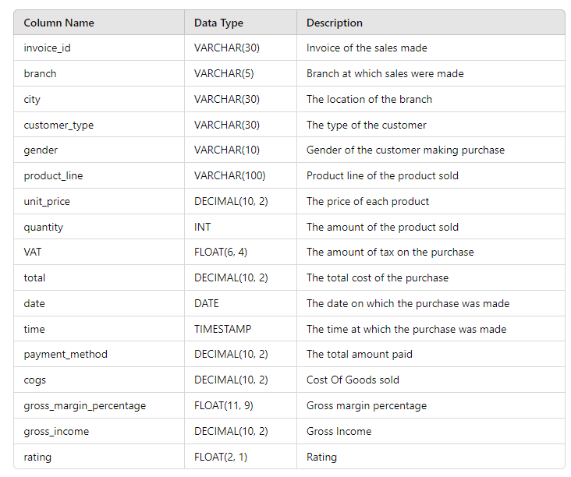
Table Description
Sales

Slide 3
Generic Question

Slide 4
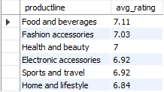
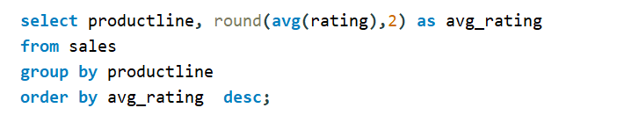
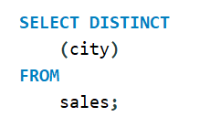
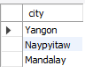
What is the average rating of each product line
How many unique cities does the data have

Slide 5
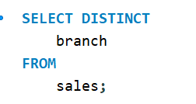
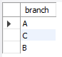
In which city is each branch

Slide 6
Product

Slide 7
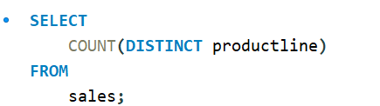
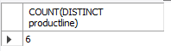
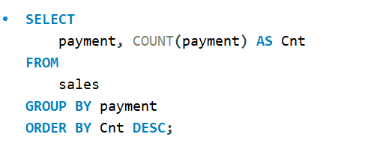
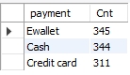
How many unique product lines does the data have
What is the most common payment method

Slide 8
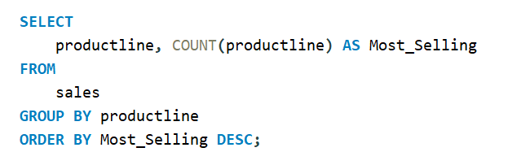
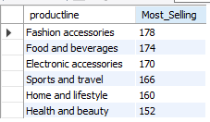
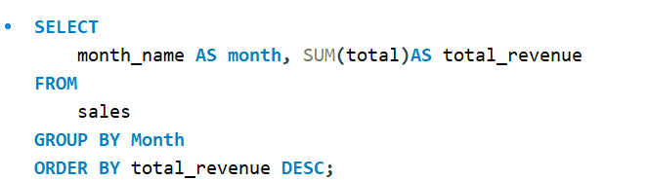
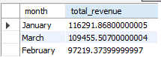
What is the most selling product line
What is the total revenue by month

Slide 9
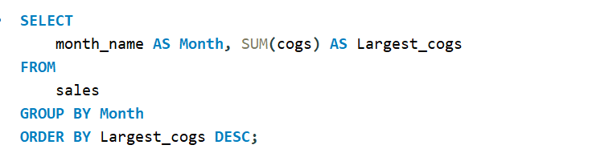
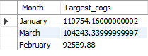
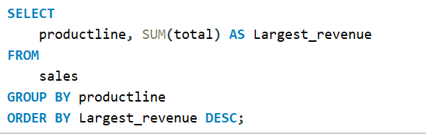
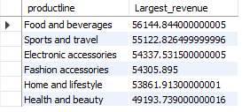
What month had the largest COGS
What productline has the largest revenue

Slide 10
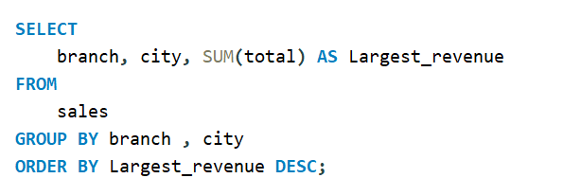
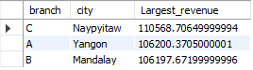
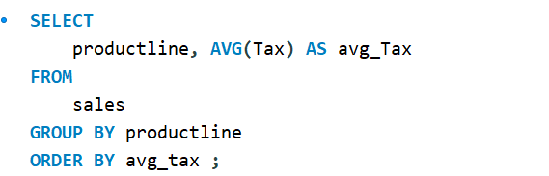
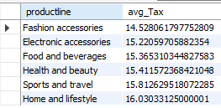
What is the city with the largest revenue
What productline has the largest VAT

Slide 11
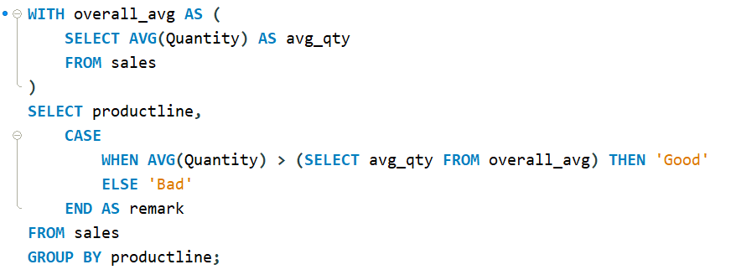
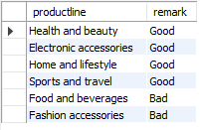
Fetch each product line and add a column to those product line showing "Good", "Bad". Good if its greater than average sales

Slide 12
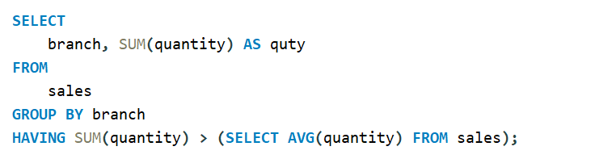
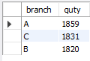
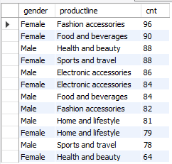
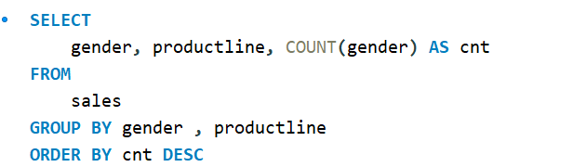
Which branch sold more products than average product sold
What is the most common product line by gender

Slide 13
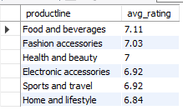
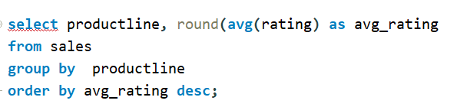
What is the average rating of each product line

Slide 14
Sales

Slide 15
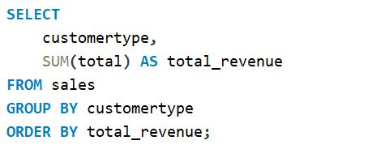
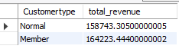
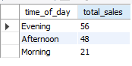
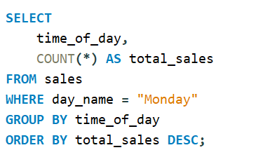
Which of the customer types brings the most revenue
Number of sales made in each time of the day per weekday
Evenings experience most sales, the stores are filled during the evening hours

Slide 16
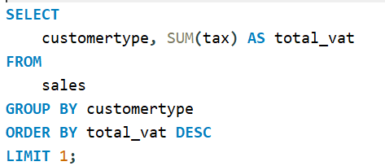
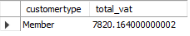
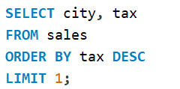
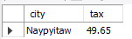
Which customer type pays the most in VAT
Which city has the largest tax percent/ VAT (Value Added Tax)

Slide 17
Customer

Slide 18
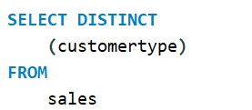
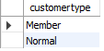
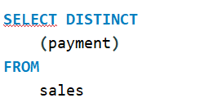
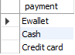
How many unique customer types does the data have
How many unique payment methods does the data have

Slide 19
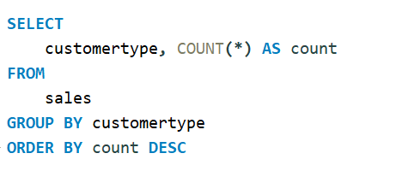
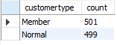
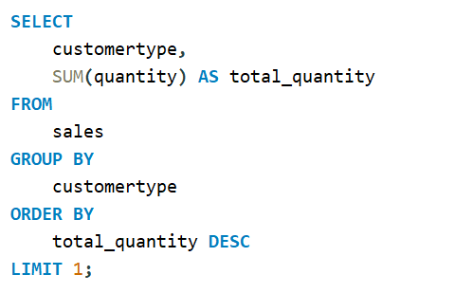
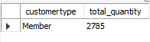
What is the most common customer type
Which customer type buys the most

Slide 20
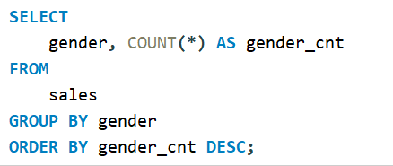
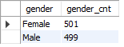


What is the gender of most of the customers
What is the gender distribution per branch
For branch – ‘A’

Slide 21




For branch – ‘B’
For branch – ‘C’
Gender per branch is more or less the same hence, I don't think has an effect of the sales per branch and other factors.

Slide 22


Which time of the day do customers give most ratings
Looks like time of the day does not really affect the rating, its more or less the same rating each time of the day

Slide 23




Which time of the day do customers give most ratings per branch
For branch – ‘A’
For branch – ‘B’

Slide 24


Branch A and C are doing well in ratings, branch B needs to do a little more to get better ratings.

Slide 25


Which day of the week has the best avg ratings
Monday, Tuesday and Friday are the top best days for good ratings

Slide 26


Which day of the week has the best average ratings per branch
For branch –’A’

Slide 27


Which day of the week has the best average ratings per branch
For branch –’B’

Slide 28


Which day of the week has the best average ratings per branch
For branch –’C’

Slide 29
Thank You
Kunal Chaudhary

